Slide 1
Final Engagement
Attack, Defense & Analysis of a Vulnerable Network

Slide 2
Table of Contents
This document contains the following resources:
Network Topology & Critical Vulnerabilities
Exploits Used
Methods Used to Avoiding Detect

Slide 3

Network Topology
& Critical Vulnerabilities
‹#›

Slide 4
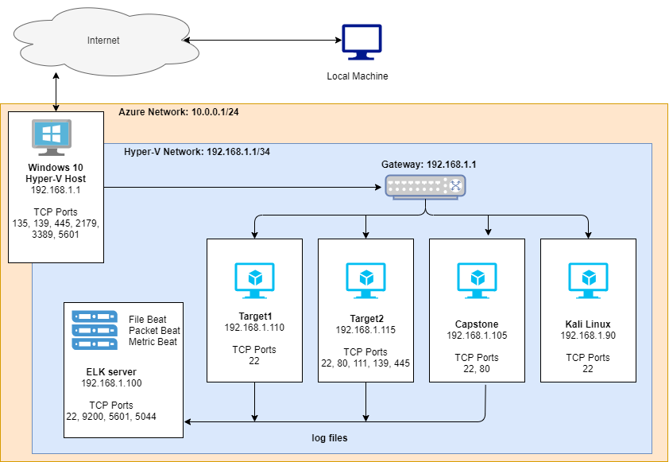
Network Topology
Network Address Range: 192.168.1.0/24
Netmask: 255.255.255.0
Gateway: 192.168.1.1
Machines
IPv4: 192.168.1.105
OS: Ubuntu 18.04.1 LTS
Hostname: CAPSTONE
IPv4: 192.168.1.100
OS: Ubuntu 18.04.4 LTS
Hostname: ELK
IPv4: 192.168.1.110
OS: Linux 3.2-4.9
Hostname: TARGET 1
IPv4: 192.168.1.115
OS: Linux 3.2-4.9
Hostname: TARGET 2

Slide 5
Critical Vulnerabilities: Target 1
Our assessment uncovered the following critical vulnerabilities in Target 1.
Vulnerability | Description | Impact
Enumeration of wordpress | Using wpscan we were able to find vulnerabilities. | Obtained usernames michael and steven.
Brute force vulnerability | Brute force to obtain login credentials. | Gaining access to the system via ssh, allowing for further enumeration of the system.
Misconfigured Permissions and Access Privileges | Users can view and access important files. | . Obtaining database login credentials.

Slide 6
Exploits Used
‹#›

Slide 7
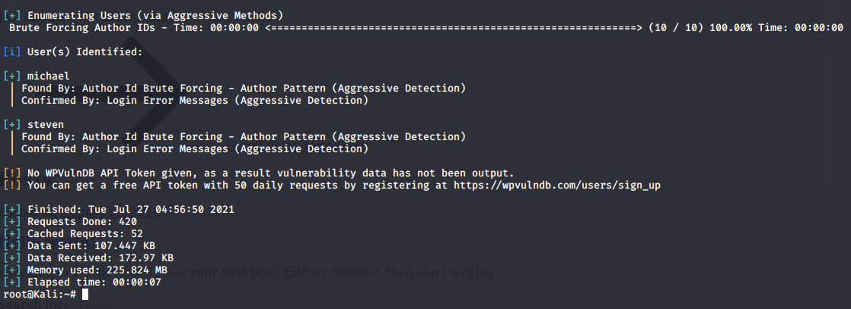
Exploitation: Enumerate Wordpress
Summarize the following:
How did you exploit the vulnerability?
wpscan --url http://192.168.1.110/wordpress/ --detection-mode aggressive -e ap,u
What did the exploit achieve?
Revealed two user names, michael and steven. This is critical information as it was used to brute force into the system via ssh.

Slide 8
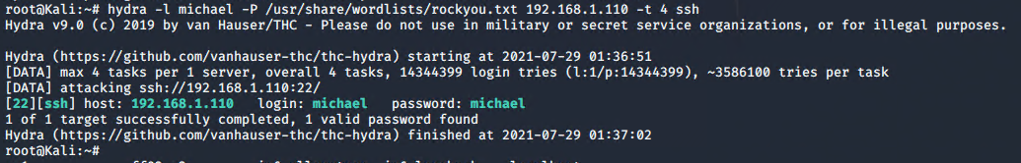
Exploitation: Brute Force Vulnerability
Summarize the following:
How did you exploit the vulnerability?
hydra -l michael 192.168.1.110 -t 4 ssh
What did the exploit achieve?
Obtained remote access onto the system via ssh.

Slide 9
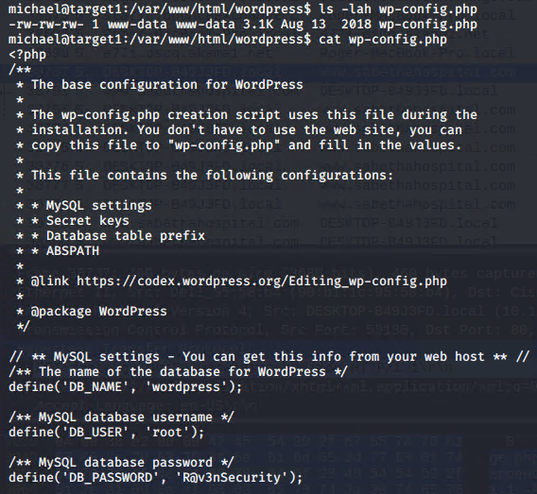
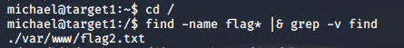
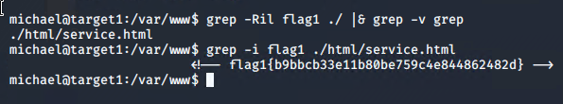
Exploitation: Misconfigured Permissions and Privileges
Summarize the following:
How did you exploit the vulnerability?
Once logged into the system we are able to review the wp.
Use command line to obtain flags.
What did the exploit achieve?
Gain database login credentials This lead to gaining hashes and eventually root access.

Slide 10
Avoiding Detection
‹#›

Slide 11
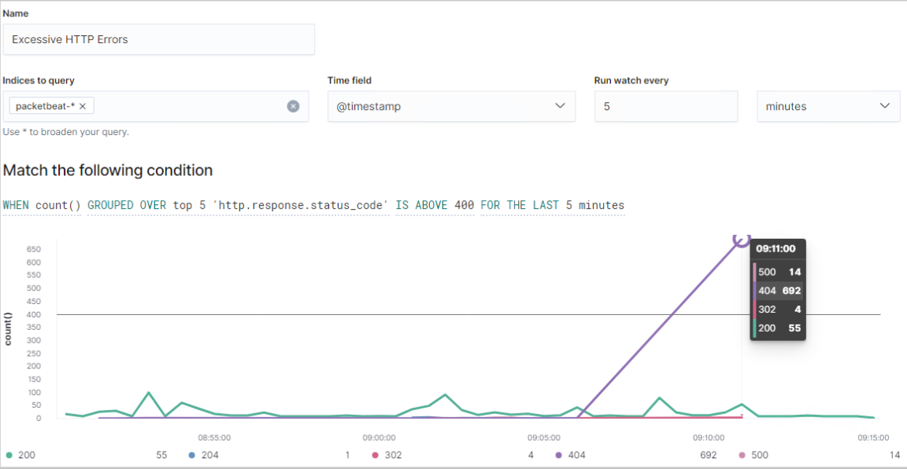
Stealth Exploitation of Wordpress Enumeration
Monitoring Overview
Which alerts detect this exploit?
WHEN count() GROUPED OVER top 5 ‘http.response.status_code’ IS ABOVE 400 FOR THE LAST 5 minutes
Which metrics do they measure?
http.response.status_code
Which thresholds do they fire at?
Above 400
Mitigating Detection
How can you execute the same exploit without triggering the alert?
Implement a pause for 5 minutes after every 100 requests
Are there alternative exploits that may perform better?
gobuster is an alternative to wpscan

Slide 12
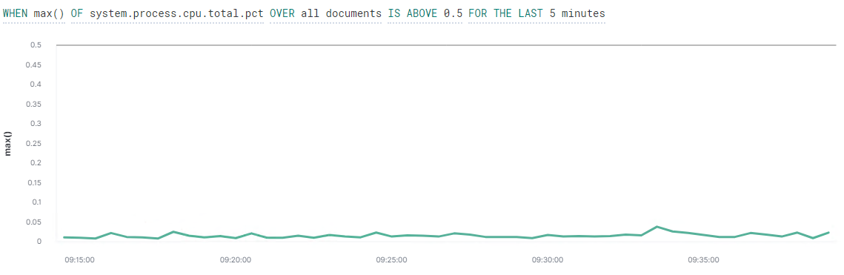
Stealth Exploitation of Brute Force Vulnerability
Monitoring Overview
Which alerts detect this exploit?
WHEN max() OF system.process.cpu.total.pct OVER all documents IS ABOVE 0.5 FOR THE LAST 5 minutes
Which metrics do they measure?
CPU Usage over the last 5 minutes.
Which thresholds do they fire at?
Exceeds 50%.
Mitigating Detection
How can you execute the same exploit without triggering the alert?
This alert did not fire, the brute force completed without stressing the system as the password was very weak and quick to crack.

